Slide 1

Regional Meeting
7.09.2024, Saturday
05.30 – 07:30 AM
It had been in the mind of Joash to repair the house of Jehovah.

Slide 2
2 Ch 24:4 And it happened after this, it had been in the mind of Joash to repair the house of Jehovah.
This work of repairing the House of Jehovah has been given to The Army of Jesus. The Lord has entrusted His Church into our hands for repair work. We should do it properly as per the command of the Lord.
1 Ch 15:13 Because you did not carry it the first time, the LORD our God broke out against us, because we did not seek him according to the rule.”
(1 Ch 15:13 For because you did not do it at the first, Jehovah our God made a break on us, since we did not seek Him in due order.)

Slide 3
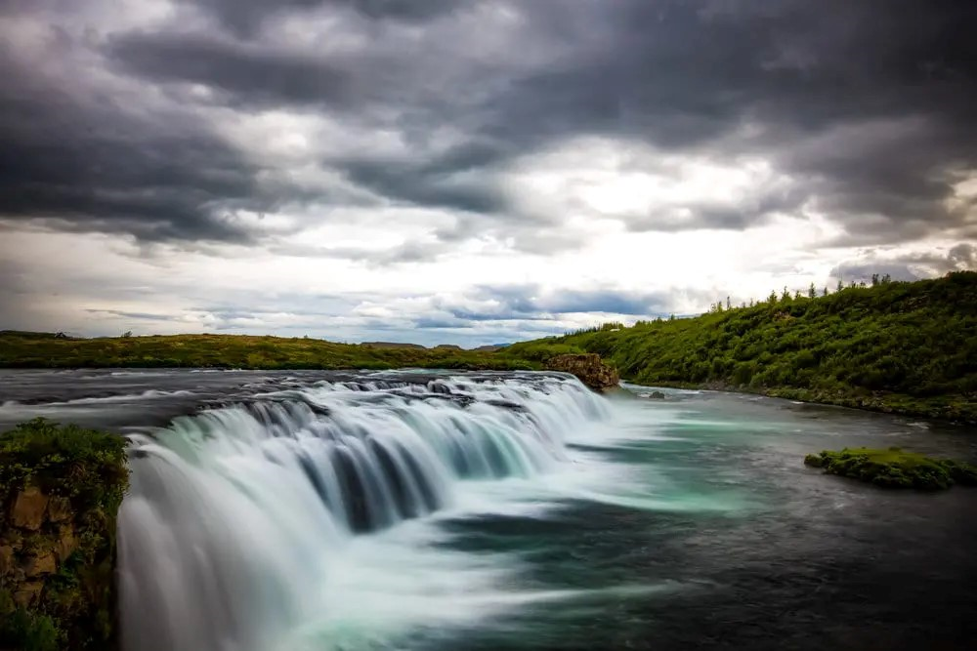
The Lord our God is a God of order. There is an order in everything he does.
1. Creation. The order of creation in 7 days.

Slide 4
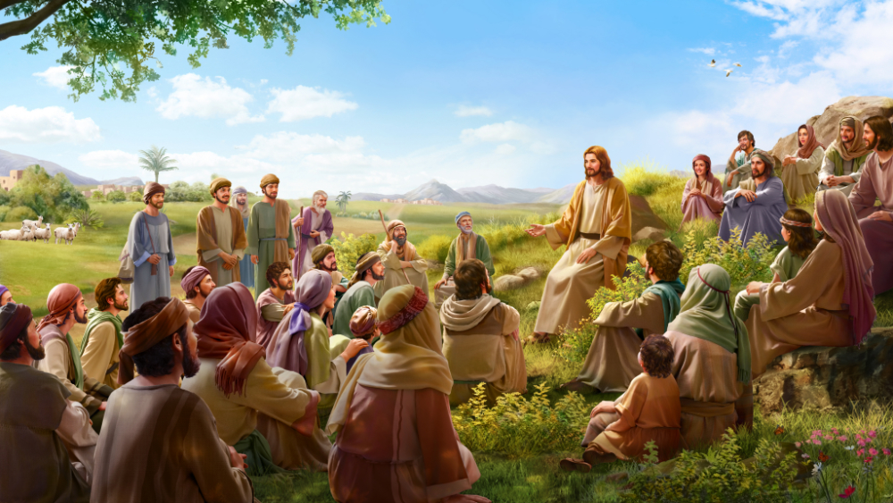
2. Jesus multiplying bread. He gave order to make them sit in fifties.
Luk 9:14 For there were about five thousand men. And he said to his disciples,
“Have them sit down in groups of about fifty each.

Slide 5
Let us see the sequence and order in which the Troop Church has to grow.
Sl no | Order of doing things | Timing | In Charge | Homework
1. | Become Troop Church Member | Any time | Troop Church Leader | Make them do the 4 daily duties of a soldier
2 | Join Morning Worship | Before 2nd week | Troop Church Leader | Give them various roles in Morning Worship
3 | Attend one Gift School either FRP 1 or Prophecy level 1 | Before 4th week | Troop Church Leader | Give feedback about the gift school to Troop Church Leader
4 | Find out members to start a new Troop Church | After 4th week | Troop Church Soldier | Keep in touch with the Troop Church Leader about starting New Troop Church

Slide 6
Let us see the sequence and order in which the Troop Church has to grow.
Sl no | Order of doing things | Timing | In Charge | Homework
5 | Try to attend BFF | In between the 8 weeks of Troop Church | Troop Church Leader | Pray for an opportunity to attend BFF Attend Fellowship Meeting
6. | Become an SMLA | After attending BFF or at least a gift School & joining morning prayer | The SMP of the area | Learn the duties of SMLA and execute them perfectly
7 | Start a new Troop Church | After 8 weeks of attending Troop Church | Troop Church Leader | Go through the handbook of Troop Church Learn the Pledge and slogan by heart Try to learn more about Troop Church by attending the Regional Meetings and other operations of AOJ

Slide 7
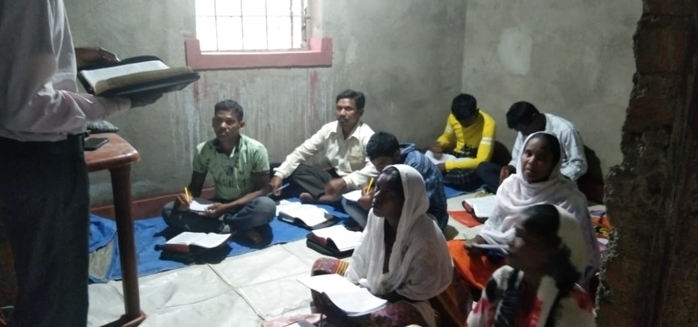
The responsibility of the Troop Church Leader during the 8 weeks is great . They have to concentrate fully on their Troop members for this 60 days since they are going to be pillars for the further growth of disciples.
In the conducting of Troop Churches, the method and order we have to follow is given above.
If Troop Churches are not growing as we expected, this can be one of the reason. We did not do things in an orderly way. Let us ask pardon from the Lord .

Slide 8
When the Lord gives us a revelation, we have to execute it. In executing we have to ask Him the order of doing things. We should not change the order.
The Lord’s eyes were upon you, roaming around & found you faithful in little things; That is why He entrusted His precious treasure – souls –the souls of BFF with you.
Luk 16:12 And if you have not been faithful in that which is another's, who will give you that which is your own?

Slide 9
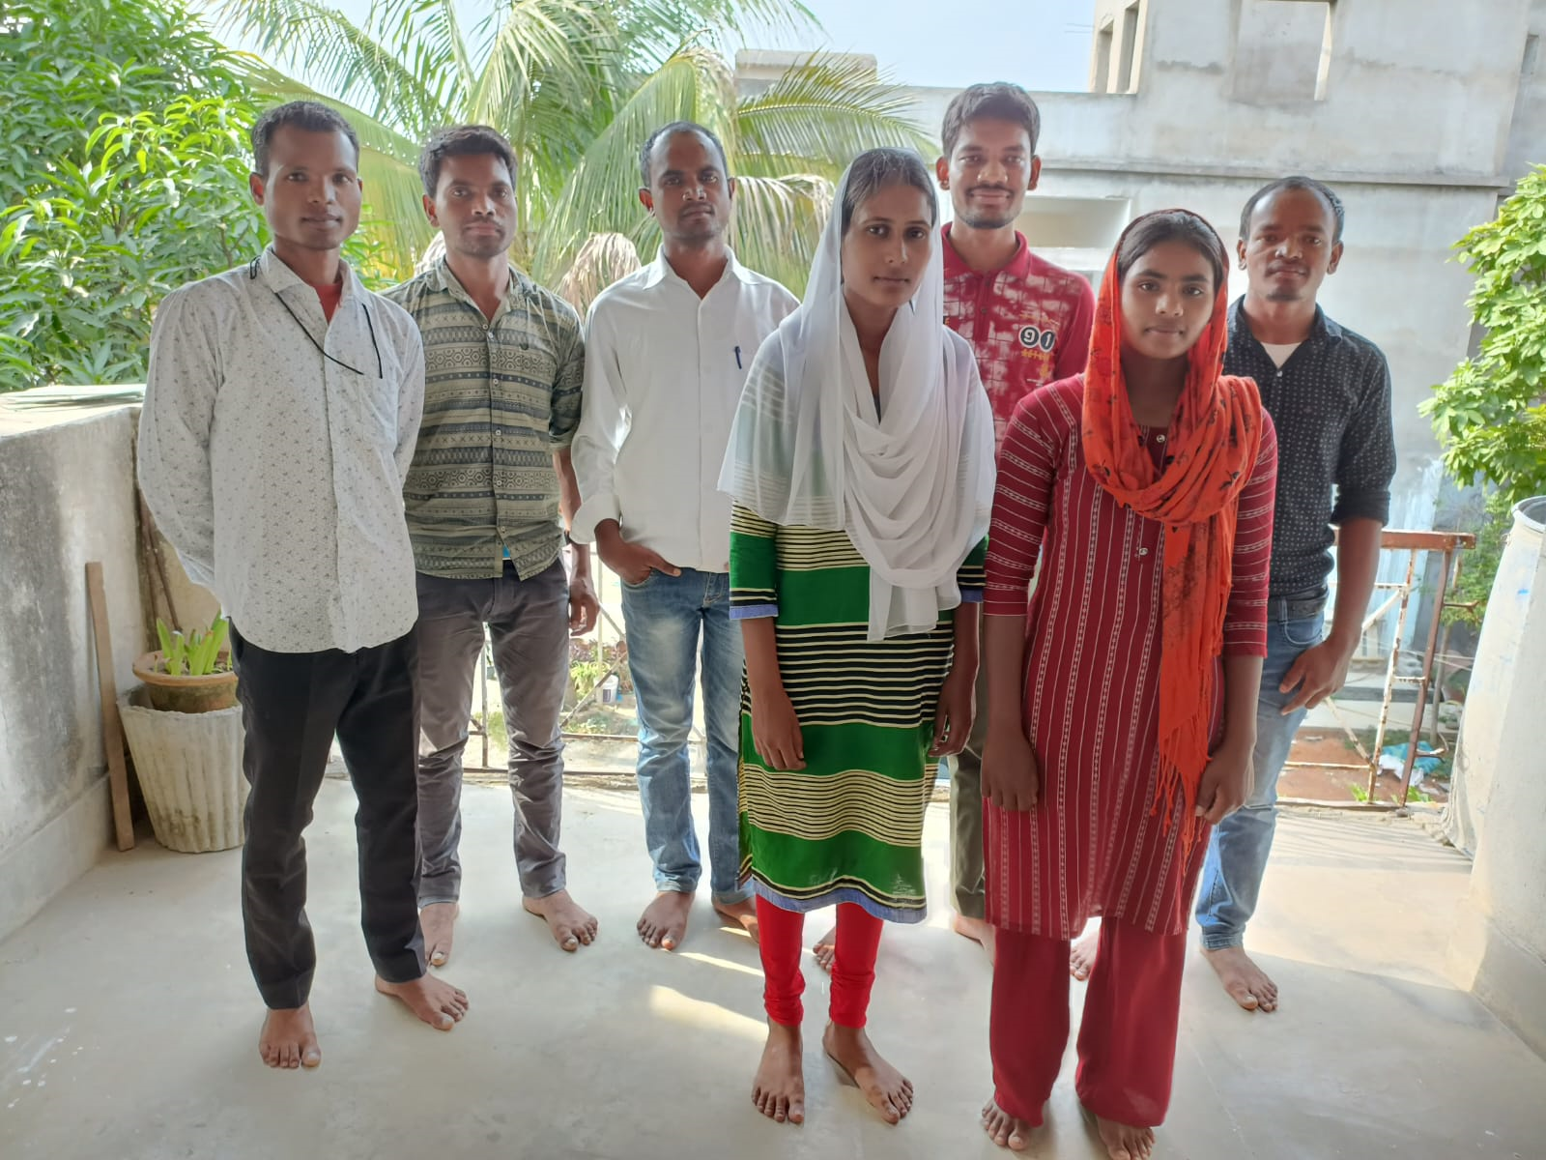
When the Lord gives us 10 souls, we should not take them lightly. The value of a single soul is more than this whole world. Entrusting a Troop Church with you is far greater than entrusting 10 worlds with us.
How much carefully should we handle them? If we lose even one of them, we should give an account to the shepherd who entrusted them with us..

Slide 10
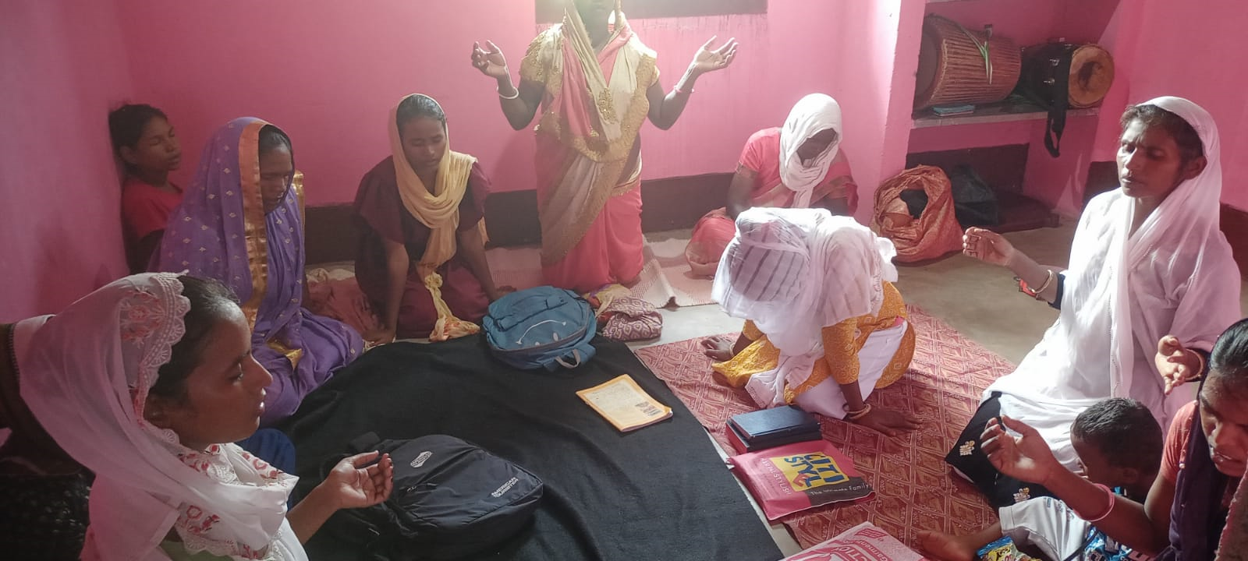
Joh 17:12 While I was with them, I kept them in your name, which you have given me. I have guarded them, and not one of them has been lost except the son of destruction, that the Scripture might be fulfilled.
How Jesus gave an account of the 12 disciples to His Father is described in His last prayer John 12. He gives account even about Judas, the one who allowed satan to enter into him.

Slide 11
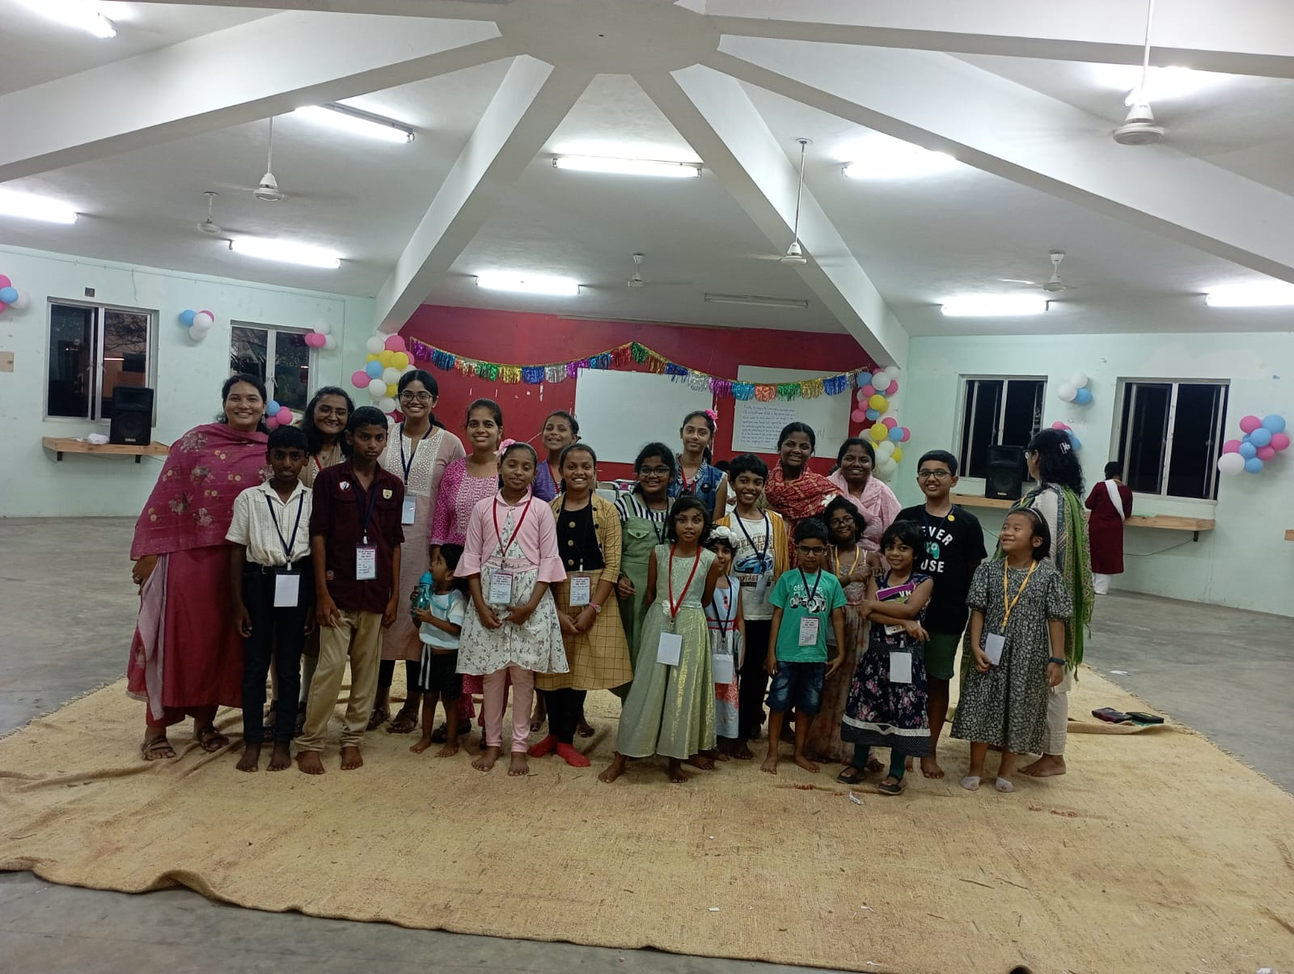
“Lord you entrusted 10 souls with me to change them into disciples. I have kept them with me in your name for 2 months . They have started making disciples for you and have started building new Troop Churches. They are fulfilling your command of going to the whole world and preaching your gospel. None of them went away from you. Thank you Lord for giving me new souls every 2 months. I will keep on doing this till my last breath, till the whole world is evangelized.”
Dear AOJ Soldier,
Can you pray the same prayer along with Jesus?

Slide 12
2 Ch 24:13 And the workmen worked, and the work was completed by them, and they set the house of God in its proper state and made it strong.
We the soldiers, though we are few, will complete the work of setting the house of God, the Church, in its proper order throughout the world. Let us take the Troop Church strategy, throughout the world. Yes, let us set the house of the Lord in order, in its proper state as it was in the beginning in the first century.

Slide 13
Act 2:42-47 And they devoted themselves to the apostles' teaching and the fellowship, to the breaking of bread and the prayers. And awe came upon every soul, and many wonders and signs were being done through the apostles.
And all who believed were together and had all things in common. And they were selling their possessions and belongings and distributing the proceeds to all, as any had need.
And day by day, attending the temple together and breaking bread in their homes, they received their food with glad and generous hearts, praising God and having favor with all the people. And the Lord added to their number day by day those who were being saved.

